Slide 1
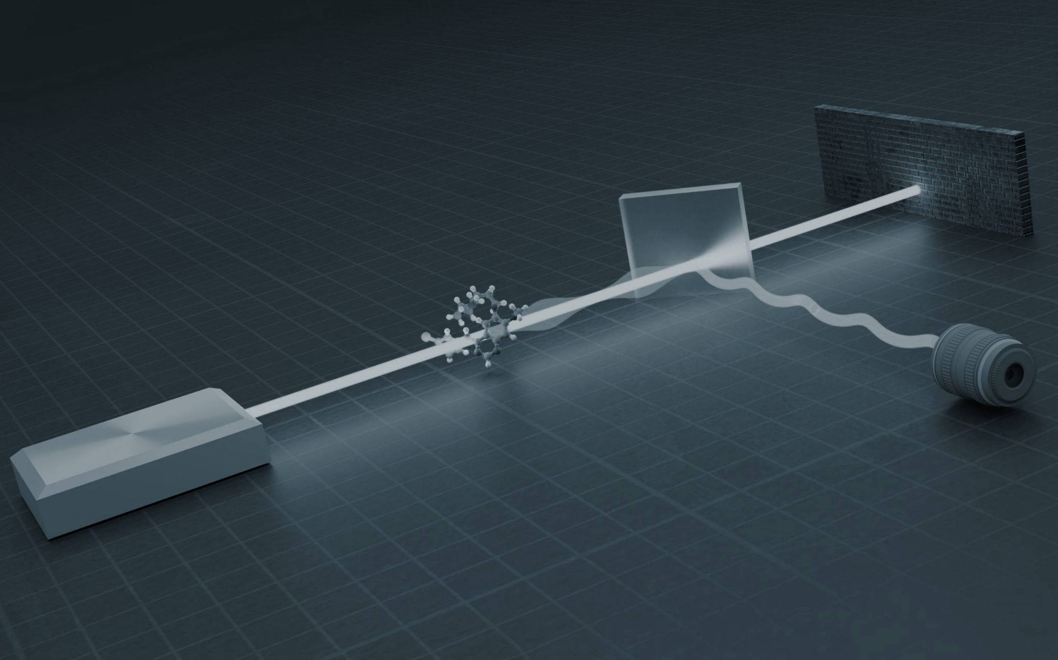

Strategies for Positive Partial Transpose (PPT) States in Quantum Metrologies with Noise
By Arunava Majumder
arunavaangshuman@gmail.com,
https://www.mdpi.com/1099-4300/23/6/685

Slide 2

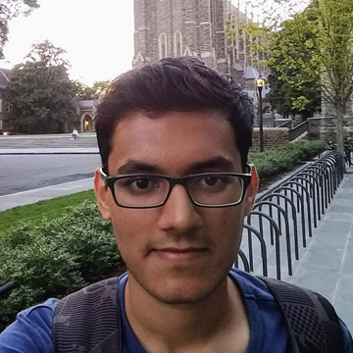

COLLABORATORS
Dr. LEONG CHUAN KWEK
HARSHANK SHROTRIYA

Slide 3
Arunava Majumder (IITKGP) Quantum Metrology September 6, 2021
OVERVIEW OF THE TALK
Quantum Foundation and information
Quantum Metrology
Noisy Quantum Channels and their effects

Slide 4
Quantum Foundation and information

Slide 5
Bound Entangled or PPT entangled states
Theorem: A higher dimensional PPT
state (i.e. a state that remains positive
under partial transposition) cannot be
distilled (pure entanglement can’t be extracted using distillation protocols).

Slide 6
Arunava Majumder (IITKGP) Quantum Metrology September 6, 2021
PPT ENTANGLED STATES
Bipartite Quantum states
( 2×2 and 2×3)
PPT CRITERIA

Slide 7
Arunava Majumder (IITKGP) Quantum Metrology September 6, 2021
PPT ENTANGLED STATES
Bipartite Quantum states
( 2×2 and 2×3)
PPT CRITERIA
PPT
NPT

Slide 8
Arunava Majumder (IITKGP) Quantum Metrology September 6, 2021
PPT ENTANGLED STATES
Bipartite Quantum states
( 2×2 and 2×3)
PPT CRITERIA
PPT
NPT
SEPARABLE
STATE
ENTANGLED
STATE

Slide 9
Arunava Majumder (IITKGP) Quantum Metrology September 6, 2021
PPT ENTANGLED STATES
Bipartite Quantum states
( 2×2 and 2×3)
PPT CRITERIA
NOISE
Classical
in nature
PPT
NPT
DISTILLABLE
SEPARABLE
STATE
ENTANGLED
STATE

Slide 10
Arunava Majumder (IITKGP) Quantum Metrology September 6, 2021
PPT ENTANGLED STATES
Bipartite Quantum states
(>2×3 dim. states)
PPT CRITERIA
NOISE
Not classical in nature
PPT
NPT
DISTILLABLE
OR
ENTANGLED
STATE
SEPARABLE
STATE
ENTANGLED
STATE

Slide 11
Arunava Majumder (IITKGP) Quantum Metrology September 6, 2021
PPT ENTANGLED STATES
Bipartite Quantum states
(>2×3 dim. states)
PPT CRITERIA
NOISE
Not classical in nature
PPT
NPT
DISTILLABLE
OR
ENTANGLED
STATE
SEPARABLE
STATE
ENTANGLED
STATE

Slide 12
Quantum Metrology

Slide 13
METROLOGY: The science of measurement
A measurement is a physical process which estimates the quantity of a particular observable (or a physical parameter) of a quantum system.
The measurement precision depends on both the performance imperfections and the fundamental limit imposed by the physical laws.

Slide 14
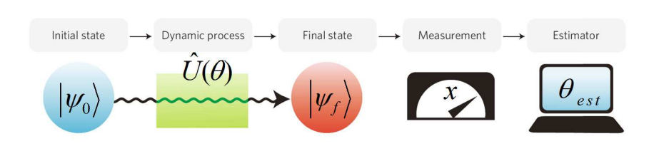
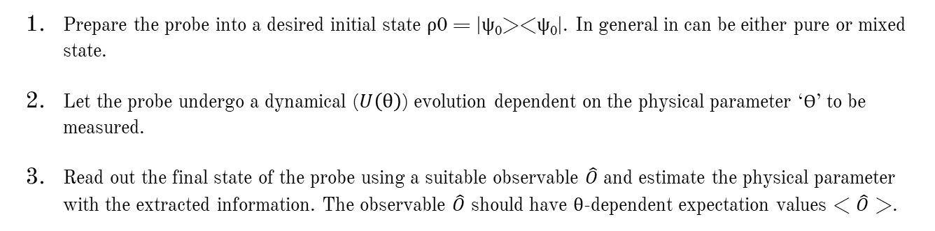
General procedure of Measurements
Arunava Majumder (IITKGP) Quantum Metrology September 6, 2021
Prepare the probe into a desired initial state ρ0 = |ψ₀><ψ₀|. In general in can be either pure or mixed state.
Let the probe undergo a dynamical ($U\left(θ\right)$) evolution dependent on the physical parameter ‘Ɵ’ to be measured.
Read out the final state of the probe using a suitable observable $\hat{O}$ and estimate the physical parameter with the extracted information. The observable $\hat{O}$ should have θ-dependent expectation values < $\hat{O}$ >.
https://doi.org/10.1142/9789814590174_0007

Slide 15
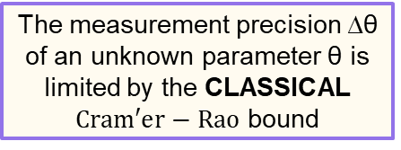
Classical lower bound to Measurements
Arunava Majumder (IITKGP) Quantum Metrology September 6, 2021
We are focusing on single parameter estimation.
The measurement precision ∆θ of an unknown parameter θ is limited by the CLASSICAL $Cram′er−Rao$ bound
https://doi.org/10.1142/9789814590174_0007

Slide 16
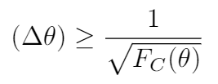
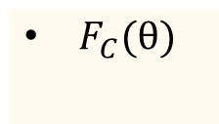
Classical lower bound to Measurements
Arunava Majumder (IITKGP) Quantum Metrology September 6, 2021
We are focusing on single parameter estimation.
The measurement precision ∆θ of an unknown parameter θ is limited by the CLASSICAL $Cram′er−Rao$ bound
$F_{C}(θ)$
CLASSICAL FISHER INFORMATION
https://doi.org/10.1142/9789814590174_0007

Slide 17
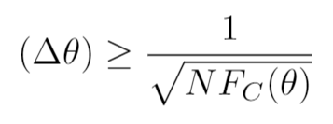
Classical lower bound to Measurements
Arunava Majumder (IITKGP) Quantum Metrology September 6, 2021
We are focusing on single parameter estimation.
After N repetition
The measurement precision ∆θ of an unknown parameter θ is limited by the CLASSICAL $Cram′er−Rao$ bound
$F_{C}(θ)$
CLASSICAL FISHER INFORMATION
https://doi.org/10.1142/9789814590174_0007

Slide 18
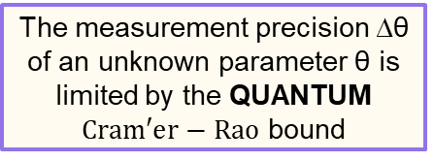
Quantum lower bound to Measurements
Arunava Majumder (IITKGP) Quantum Metrology September 6, 2021
We are focusing on single parameter estimation.
The measurement precision ∆θ of an unknown parameter θ is limited by the QUANTUM $Cram′er−Rao$ bound
https://doi.org/10.1142/9789814590174_0007

Slide 19
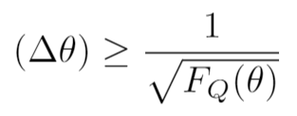
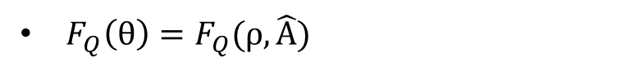
Quantum lower bound to Measurements
Arunava Majumder (IITKGP) Quantum Metrology September 6, 2021
We are focusing on single parameter estimation.
The measurement precision ∆θ of an unknown parameter θ is limited by the QUANTUM $Cram′er−Rao$ bound
$F_{Q}\left(θ\right)=F_{Q}(ρ,\hat{A})$
QUANTUM FISHER INFORMATION
https://doi.org/10.1142/9789814590174_0007

Slide 20
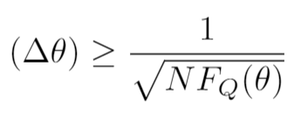
Quantum lower bound to Measurements
Arunava Majumder (IITKGP) Quantum Metrology September 6, 2021
We are focusing on single parameter estimation.
After N repetition
The measurement precision ∆θ of an unknown parameter θ is limited by the QUANTUM $Cram′er−Rao$ bound
$F_{Q}\left(θ\right)=F_{Q}(ρ,\hat{A})$
QUANTUM FISHER INFORMATION
https://doi.org/10.1142/9789814590174_0007

Slide 21
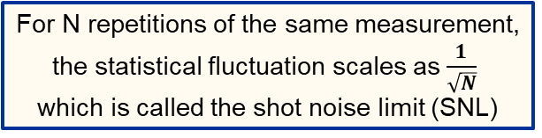
Arunava Majumder (IITKGP) Quantum Metrology September 6, 2021
Limits imposed by Nature
For N repetitions of the same measurement, the statistical fluctuation scales as $\frac{1}{\sqrt{N}}$ which is called the shot noise limit (SNL)
SHOT NOISE LIMIT (SNL)

Slide 22
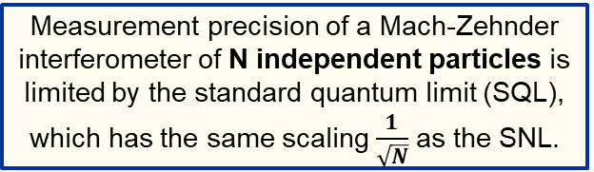
Arunava Majumder (IITKGP) Quantum Metrology September 6, 2021
Limits imposed by Nature
For N repetitions of the same measurement, the statistical fluctuation scales as $\frac{1}{\sqrt{N}}$ which is called the shot noise limit (SNL)
SHOT NOISE LIMIT (SNL)
Measurement precision of a Mach-Zehnder interferometer of N independent particles is limited by the standard quantum limit (SQL), which has the same scaling $\frac{1}{\sqrt{N}}$as the SNL.
STANDARD QUANTUM LIMIT (SQL)

Slide 23
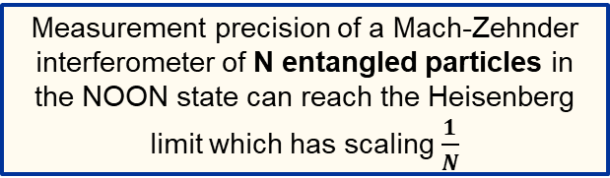
Arunava Majumder (IITKGP) Quantum Metrology September 6, 2021
Limits imposed by Nature
For N repetitions of the same measurement, the statistical fluctuation scales as $\frac{1}{\sqrt{N}}$ which is called the shot noise limit (SNL)
SHOT NOISE LIMIT (SNL)
Measurement precision of a Mach-Zehnder interferometer of N independent particles is limited by the standard quantum limit (SQL), which has the same scaling $\frac{1}{\sqrt{N}}$as the SNL.
STANDARD QUANTUM LIMIT (SQL)
Measurement precision of a Mach-Zehnder interferometer of N entangled particles in the NOON state can reach the Heisenberg limit which has scaling $\frac{1}{N}$
HEISENBERG LIMIT (HL)

Slide 24
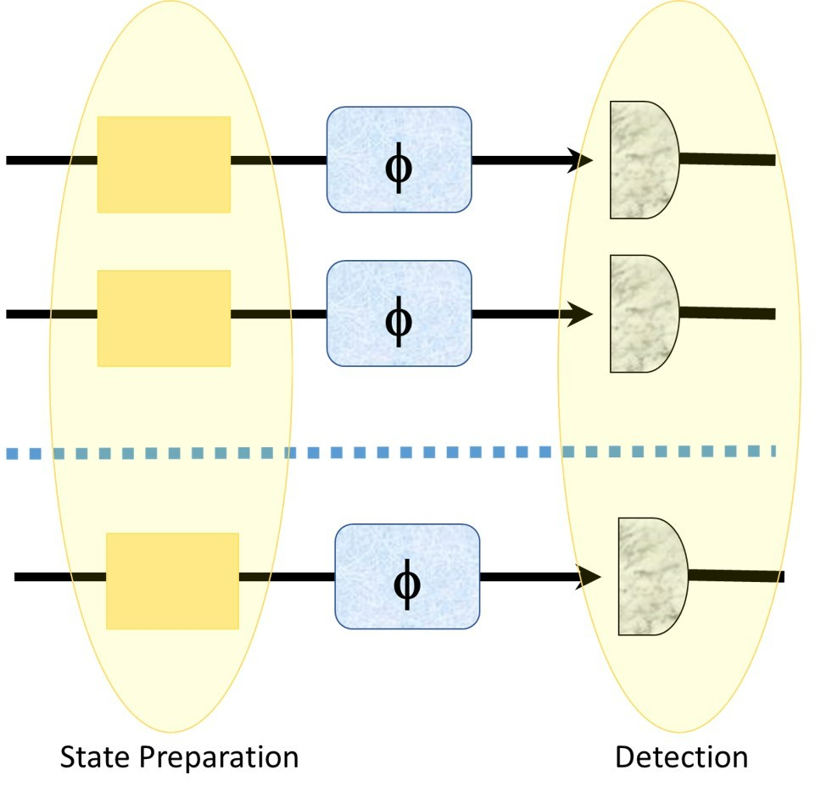
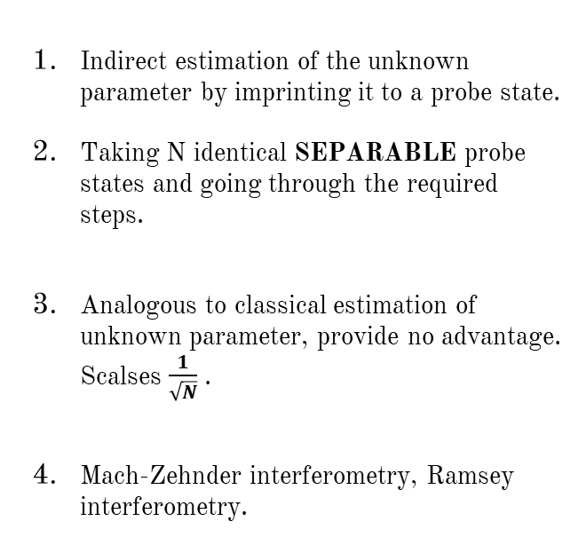
Experimental Realization 1
Arunava Majumder (IITKGP) Quantum Metrology September 6, 2021
Indirect estimation of the unknown parameter by imprinting it to a probe state.
Taking N identical SEPARABLE probe states and going through the required steps.
Analogous to classical estimation of unknown parameter, provide no advantage. Scalses $\frac{1}{\sqrt{N}}$ .
Mach-Zehnder interferometry, Ramsey interferometry.
https://doi.org/10.1142/9789814590174_0007
, https://doi.org/10.3390/e23060685

Slide 25
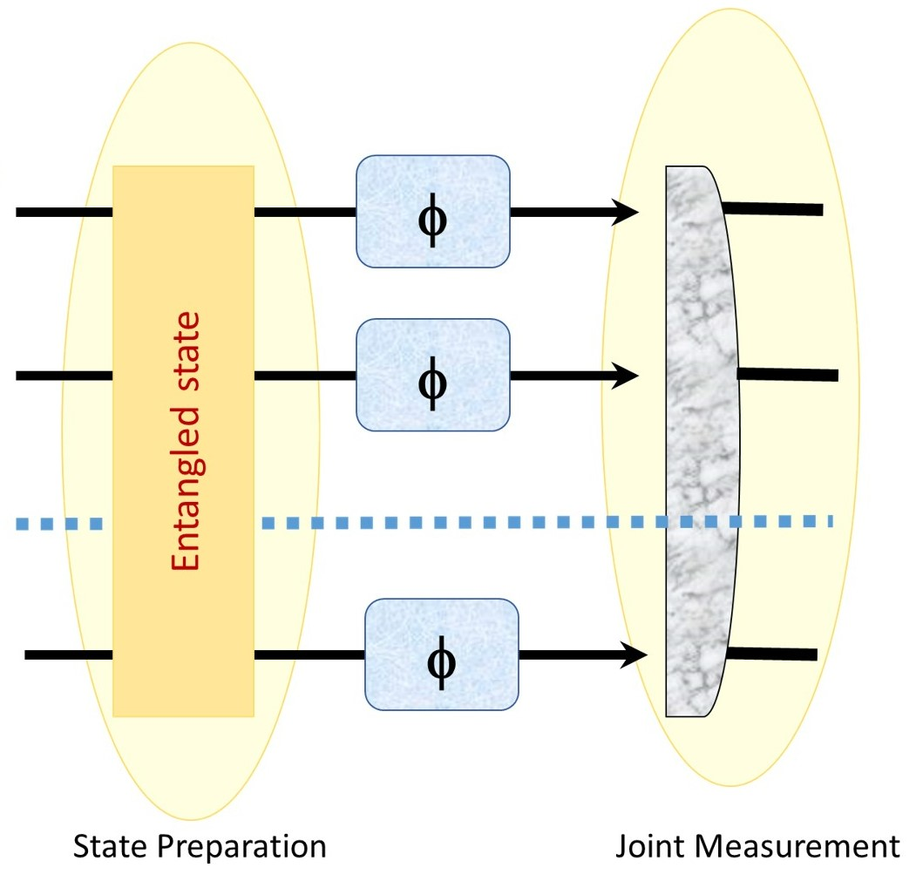
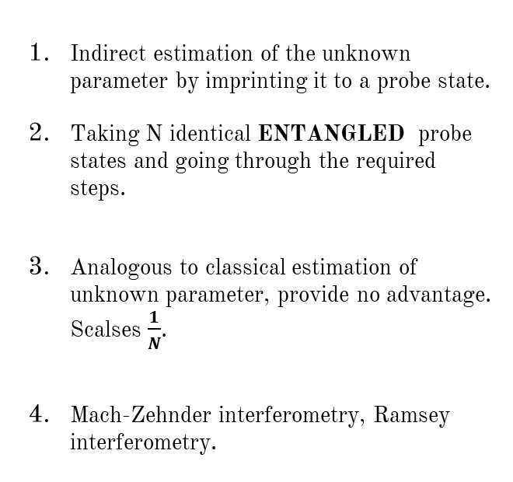
Experimental Realization 2
Arunava Majumder (IITKGP) Quantum Metrology September 6, 2021
Indirect estimation of the unknown parameter by imprinting it to a probe state.
Taking N identical ENTANGLED probe states and going through the required steps.
Analogous to classical estimation of unknown parameter, provide no advantage. Scalses $\frac{1}{N}$.
Mach-Zehnder interferometry, Ramsey interferometry.
https://doi.org/10.1142/9789814590174_0007
, https://doi.org/10.3390/e23060685

Slide 26
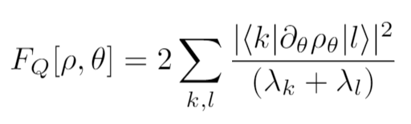
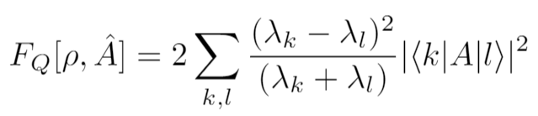
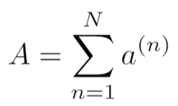
Quantum Fisher Information (QFI)
Arunava Majumder (IITKGP) Quantum Metrology September 6, 2021
We are focusing on single parameter estimation.
The
Encoder
https://doi.org/10.3390/e23060685

Slide 27
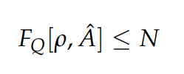
Quantum Fisher Information (QFI)
Arunava Majumder (IITKGP) Quantum Metrology September 6, 2021
We are focusing on single parameter estimation.
The
Encoder
Multi-qubit
separable state
N=Total number of subsystems not particles
https://doi.org/10.3390/e23060685

Slide 28
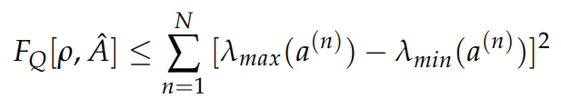
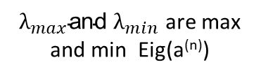
Quantum Fisher Information (QFI)
Arunava Majumder (IITKGP) Quantum Metrology September 6, 2021
We are focusing on single parameter estimation.
The
Encoder
Multi-qubit
separable state
Multi-qudit
separable state
N=Total number of subsystems not particles
${λ_{max}\text{and} λ}_{min}$ are max and min Eig(a^{(n)})
https://doi.org/10.3390/e23060685

Slide 29



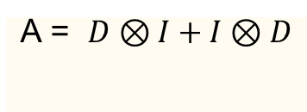
Arunava Majumder (IITKGP) Quantum Metrology September 6, 2021
Parameter encoding schemes
D=Diag[1,1,…,-1,-1]
Further we’ll only consider Bipartite systems of various dimensions
ENTANGLED ASSISTED STRATEGY
ANCILLA ASSISTED STRATEGY
A = $D⊗I+I⊗D$
A = $D⊗I or I⊗D$
https://doi.org/10.3390/e23060685

Slide 30
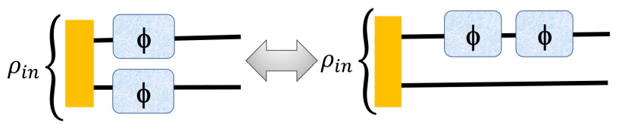
Arunava Majumder (IITKGP) Quantum Metrology September 6, 2021
Adding Sequence to parameter encoding schemes
Considering only Bipartite systems of various dimensions
ENTANGLED
ASSISTED STRATEGY
SEQUENTIAL ANCILLA ASSISTED STRATEGY
A = $D⊗I+I⊗D$
https://doi.org/10.3390/e23060685

Slide 31

Arunava Majumder (IITKGP) Quantum Metrology September 6, 2021
Adding Sequence to parameter encoding schemes
Considering only Bipartite systems of various dimensions
ENTANGLED
ASSISTED STRATEGY
SEQUENTIAL ANCILLA ASSISTED STRATEGY
A = $D⊗I+I⊗D$
A = $D⊗I + D⊗I$
https://doi.org/10.3390/e23060685

Slide 32
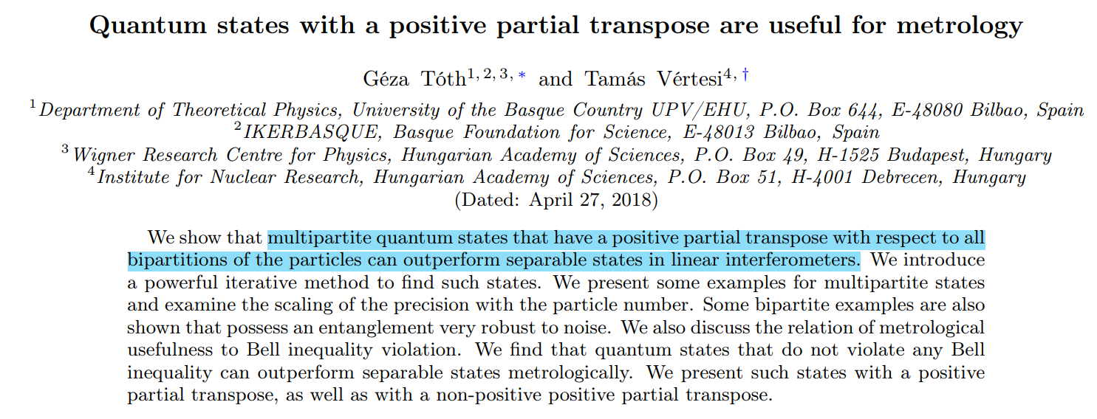
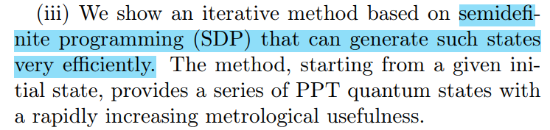
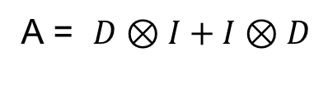
Arunava Majumder (IITKGP) Quantum Metrology September 6, 2021
Optimal probe state and optimal encoder
A = $D⊗I+I⊗D$
https://doi.org/10.1103/PhysRevLett.120.020506

Slide 33
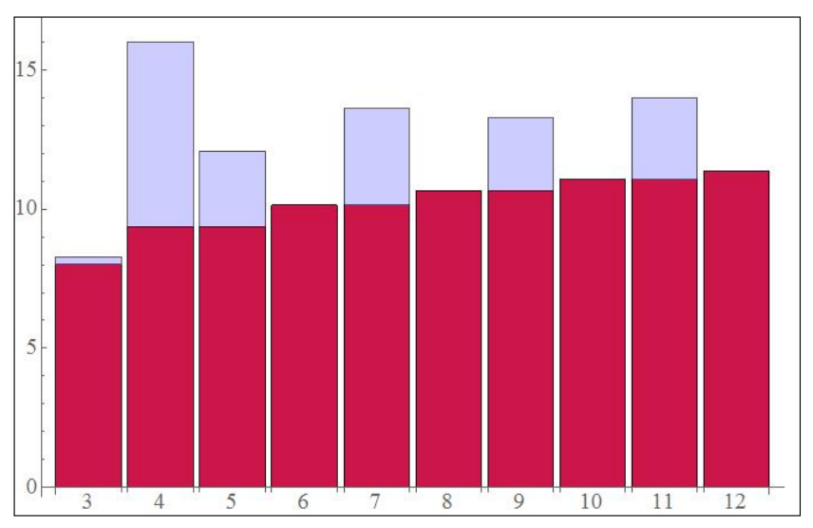
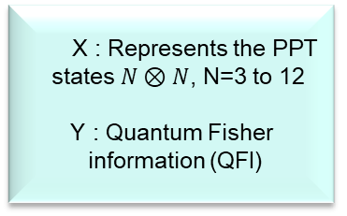
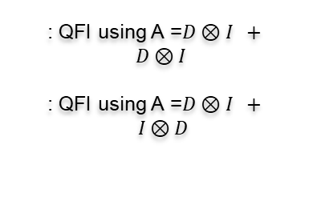
Arunava Majumder (IITKGP) Quantum Metrology September 6, 2021
RESULT 1
X : Represents the PPT
states $N⊗N$, N=3 to 12
Y : Quantum Fisher
information (QFI)
: QFI using A =$D⊗I + D⊗I$
: QFI using A =$D⊗I + I⊗D$
https://doi.org/10.3390/e23060685

Slide 34
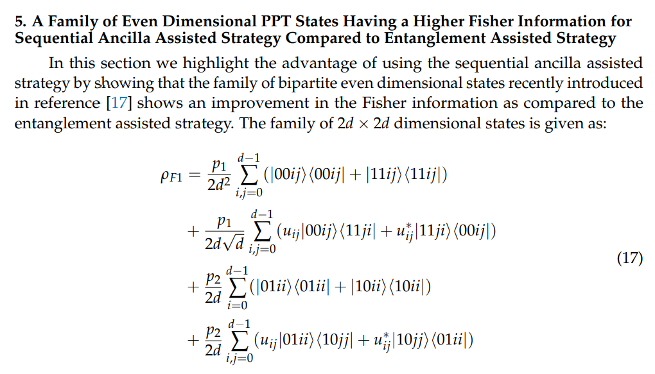
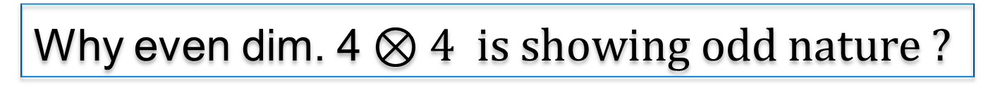
Arunava Majumder (IITKGP) Quantum Metrology September 6, 2021
Why even dim. 4$⊗4 is showing odd nature ?$
The family we are talking about here is different from the family of states found from SDP
https://doi.org/10.1103/PhysRevResearch.3.023101 , https://doi.org/10.3390/e23060685

Slide 35

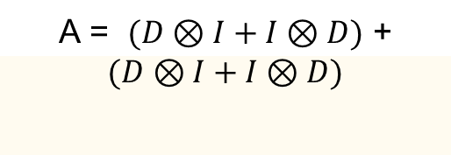
Arunava Majumder (IITKGP) Quantum Metrology September 6, 2021
Parameter encoding schemes with Multiple Sequences
Considering only Bipartite systems of various dimensions
SEQUENTIAL ENTANGLED
ASSISTED STRATEGY
SEQUENTIAL ANCILLA ASSISTED STRATEGY
A = $\left(D⊗I + D⊗I\right)+$
$(D⊗I + D⊗I$)
A = $(D⊗I+I⊗D)$ +
$$(D⊗I+I⊗D)$$
https://doi.org/10.3390/e23060685

Slide 36
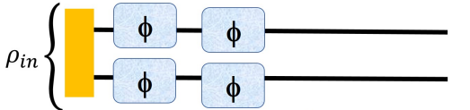
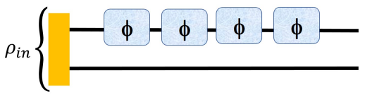
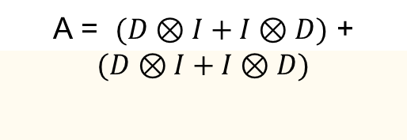
Arunava Majumder (IITKGP) Quantum Metrology September 6, 2021
Parameter encoding schemes with Multiple Sequences
Considering only Bipartite systems of various dimensions
SEQUENTIAL ENTANGLED
ASSISTED STRATEGY
SEQUENTIAL ANCILLA ASSISTED STRATEGY
A = $\left(D⊗I + D⊗I\right)+$
$(D⊗I + D⊗I$)
A = $(D⊗I+I⊗D)$ +
$$(D⊗I+I⊗D)$$
https://doi.org/10.3390/e23060685

Slide 37
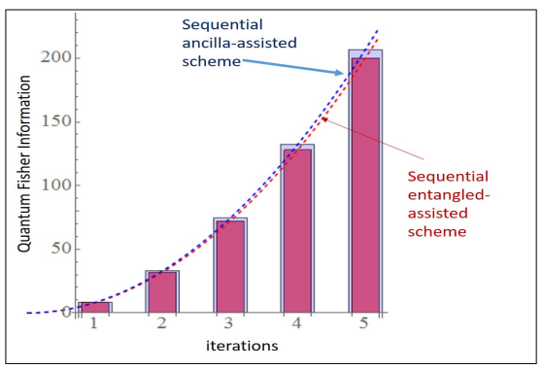
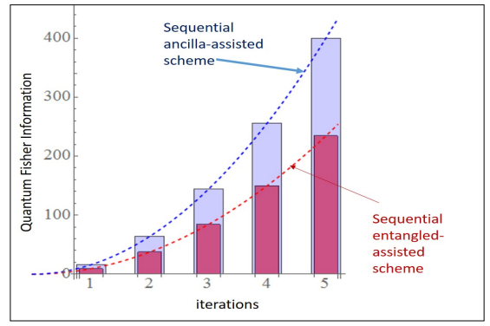
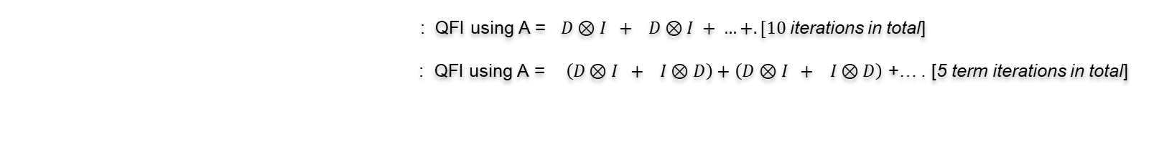
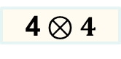
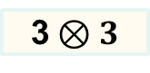
Arunava Majumder (IITKGP) Quantum Metrology September 6, 2021
RESULT 2
3$⊗3$
4$⊗4$
: QFI using A = $D⊗I + D⊗I + …+. [10$iterations in total]
: QFI using A =$\left(D⊗I + I⊗D\right)+$ $\left(D⊗I + I⊗D\right)$ +… . [5 term iterations in total]
https://doi.org/10.3390/e23060685

Slide 38
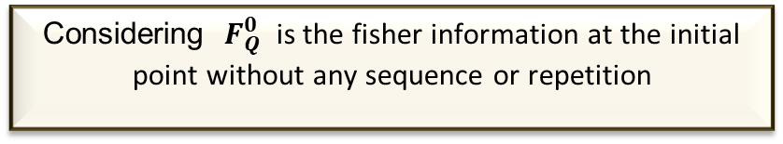
Arunava Majumder (IITKGP) Quantum Metrology September 6, 2021
Advantage of having sequences
Considering ${ F}_{Q}^{0}$ is the fisher information at the initial point without any sequence or repetition
https://doi.org/10.3390/e23060685

Slide 39
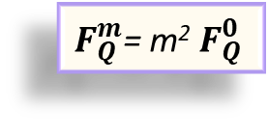
Arunava Majumder (IITKGP) Quantum Metrology September 6, 2021
Advantage of having sequences
Considering ${ F}_{Q}^{0}$ is the fisher information at the initial point without any sequence or repetition
After “m” sequences regardless of ENT or ANC assisted strategy
$F_{Q}^{m}$= m²${ F}_{Q}^{0}$
https://doi.org/10.3390/e23060685

Slide 40
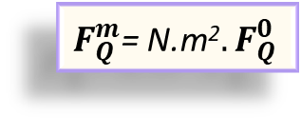
Arunava Majumder (IITKGP) Quantum Metrology September 6, 2021
Advantage of having sequences
Considering ${ F}_{Q}^{0}$ is the fisher information at the initial point without any sequence or repetition
After “m” sequences regardless of ENT or ANC assisted strategy
$F_{Q}^{m}$= m²${ F}_{Q}^{0}$
After “N” repetitions regardless of ENT or ANC assisted strategy
$F_{Q}^{m}$= N.m²${. F}_{Q}^{0}$
https://doi.org/10.3390/e23060685

Slide 41
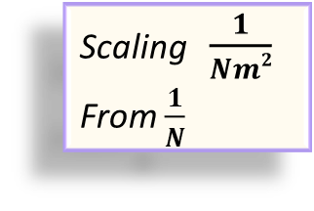
Arunava Majumder (IITKGP) Quantum Metrology September 6, 2021
Advantage of having sequences
Considering ${ F}_{Q}^{0}$ is the fisher information at the initial point without any sequence or repetition
After “m” sequences regardless of ENT or ANC assisted strategy
$F_{Q}^{m}$= m²${ F}_{Q}^{0}$
After “N” repetitions regardless of ENT or ANC assisted strategy
Scaling $\frac{1}{Nm2}$
From $\frac{1}{N}$
$F_{Q}^{m}$= N.m²${. F}_{Q}^{0}$
https://doi.org/10.3390/e23060685

Slide 42
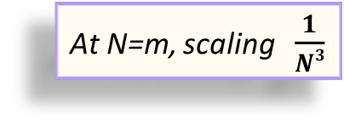
Arunava Majumder (IITKGP) Quantum Metrology September 6, 2021
Advantage of having sequences
Considering ${ F}_{Q}^{0}$ is the fisher information at the initial point without any sequence or repetition
Best possible case
After “m” sequences regardless of ENT or ANC assisted strategy
At N=m, scaling $\frac{1}{N3}$
$F_{Q}^{m}$= m²${ F}_{Q}^{0}$
After “N” repetitions regardless of ENT or ANC assisted strategy
Scaling $\frac{1}{Nm2}$
From $\frac{1}{N}$
$F_{Q}^{m}$= N.m²${. F}_{Q}^{0}$
https://doi.org/10.3390/e23060685

Slide 43
Applications
Arunava Majumder (IITKGP) Quantum Metrology September 6, 2021
Magnetometry: Magnetometry allows one to measure the magnetic field precisely by measuring the phase shift of the particles due to magnetic field(as particles are waves). If the particles are entangled, precision of this measurement will improve Quantum enhanced magnetometry
LIGO Gravitational wave detection: To improve the sensitivity of laser light, it is prepared in squeezed state which is less sensitive to noise. Thus can perform precise measurement of the periodic distortion of space and time.
Thermometry ..........

Slide 44
Noisy Quantum Channels and their effects

Slide 45
Arunava Majumder (IITKGP) Quantum Metrology September 6, 2021
Quantum Noise
Noise
https://doi.org/10.3390/e23060685

Slide 46
Arunava Majumder (IITKGP) Quantum Metrology September 6, 2021
Quantum Noise
Noise
COHERENT
INCOHERENT
https://doi.org/10.3390/e23060685

Slide 47
Arunava Majumder (IITKGP) Quantum Metrology September 6, 2021
Quantum Noise
Noise
COHERENT
INCOHERENT
Due to interaction of physical system with noisy environment.
Doesn’t maintain quantum coherence
Example: Depolarizing channel……...
Due to miscalibrations, crosstalk in hardware / experimental setup.
Maintains coherence, results in an under or over rotation
https://doi.org/10.3390/e23060685

Slide 48
Arunava Majumder (IITKGP) Quantum Metrology September 6, 2021
Incoherent Quantum Noise
Noisy channel /
CPTP map
https://doi.org/10.3390/e23060685

Slide 49
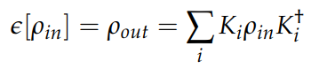
Arunava Majumder (IITKGP) Quantum Metrology September 6, 2021
Incoherent Quantum Noise
Noisy channel /
CPTP map
https://doi.org/10.3390/e23060685

Slide 50
Arunava Majumder (IITKGP) Quantum Metrology September 6, 2021
Incoherent Quantum Noise
Noisy channel /
CPTP map
Depolarizing Noisy channel
https://doi.org/10.3390/e23060685

Slide 51

Arunava Majumder (IITKGP) Quantum Metrology September 6, 2021
Incoherent Quantum Noise
Noisy channel /
CPTP map
Depolarizing Noisy channel
Asymmetric
Symmetric
https://doi.org/10.3390/e23060685

Slide 52




Arunava Majumder (IITKGP) Quantum Metrology September 6, 2021
Results including noise
3$⊗3$ and 4$⊗4$
respectively
For a total 3 sequences
11$⊗11$ and 12$⊗12$
respectively
https://doi.org/10.3390/e23060685

Slide 53
Selected in International conferences
QuApps 2021 (International Conference on Applications of Quantum Technologies).
IEEE international conference for quantum computing (among one of the 30 posters selected from all over the world).
WE-Heraeus-Seminar, an international seminar on "Sensing with Quantum Light“.
Institute of Physics Singapore (IPS meeting 2021) annual international conference.

Slide 54
THANK YOU SO MUCH!

Slide 55

Experimental Realization
Arunava Majumder (IITKGP) Quantum Metrology September 6, 2021
Various convex sets of quantum states represented by circles: (P) PPT states, (M) states that are not useful for metrology, (S) separable states, (L) states with a local hidden variable model. (grey area) Metrologically useful PPT states. Such states are in P\M, where “\” denotes the difference between two sets.
https://doi.org/10.1103/PhysRevLett.120.020506

